Slide 1
SUPPORTLYTICS
Optimizing IT Support Team Performance
Using Advanced Analytics

Slide 2
OVERVIEW
MileStone 1
MileStone 2
MileStone 3
MileStone 4

Slide 3
MILESTONE 1
Project Initialization and Data Cleaning and Feature Engineering
Module 1:- Project Initialization and Dataset Setup | Module 2:- Data Cleaning and Feature Engineering

Slide 4
MODULE 1
Project Initialization and DataSet Setup
Define objectives, KPIs, and workflow
Load the CSV dataset using pandas
Explore schema, data types, and missing values
Calculate initial ticket distribution by Type, Priority, and Category

Slide 5
Project Objective
This project analyzes IT support ticket data to uncover performance trends, optimize resolution times, and improve overall service efficiency. The analysis will translate raw ticket-level data into actionable operational recommendations for IT support leadership.
Understand and process the IT support ticket dataset.
Explore trends in ticket volume, priority, category, and channel distribution.
Identify clusters of similar issues using text similarity and clustering techniques applied to issue descriptions.
Quantify support performance through resolution time, first-response time, SLA compliance, and escalation behavior.
Visualize performance metrics through dashboards and charts.
Summarize the final analytical report and presentation.

Slide 6
Key Performance Indicators
Average Resolution Time: mean time between ticket creation and resolution/closure
First Response Time: average time to the first agent reply
Ticket Volume by Category/Type: count of tickets per issue category (billing, technical, account, etc.)
Ticket Volume by Priority: distribution across low/medium/high/urgent
Ticket Volume by Channel: split across email, chat, phone, social media
SLA Compliance Rate: % of tickets resolved within target time
Customer Satisfaction Score: average rating if a satisfaction field exists
Backlog / Open Ticket Rate: proportion of tickets still open/pending vs. closed

Slide 7
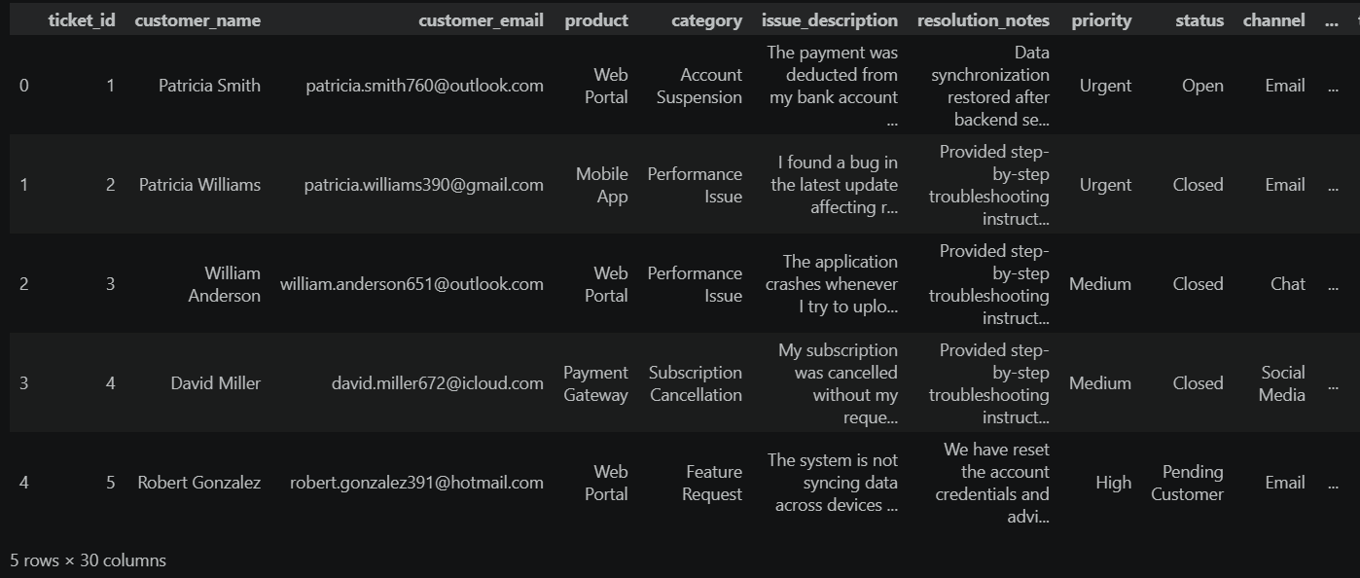
Loading Dataset

Slide 8
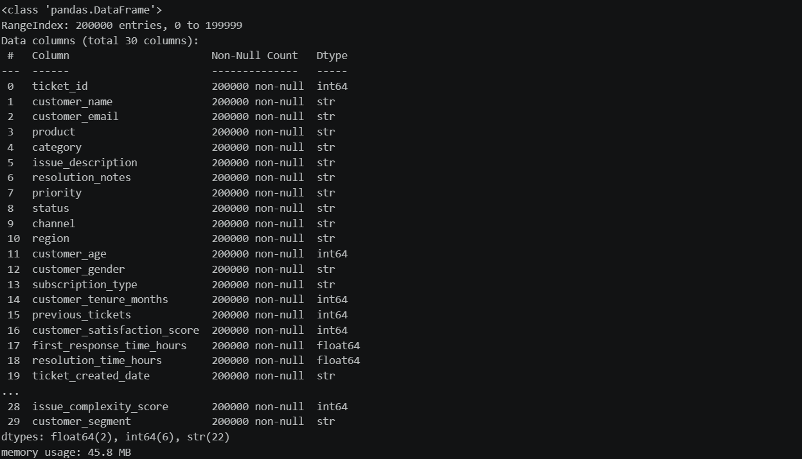
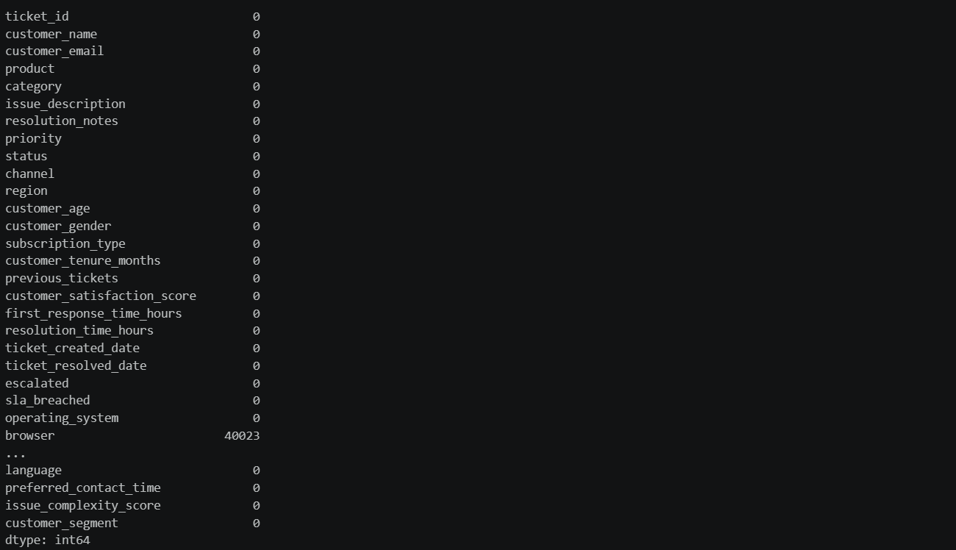
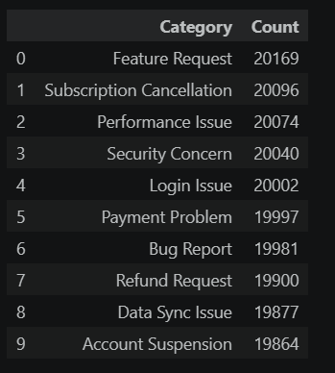
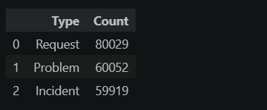
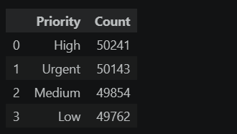
Handling Dataset
Data Type Check
Missing Values Check
Ticket Count By Type
Ticket Count By Priority
Ticket Count By Category

Slide 9
MODULE 2
Data Cleaning and Feature Engineering
Handle missing or incorrect data in text fields
Create new features: Resolution_Duration and Priority_Score
Save processed data for analysis
Deliverables: Cleaned dataset, Feature engineering summary, Data dictionary

Slide 10
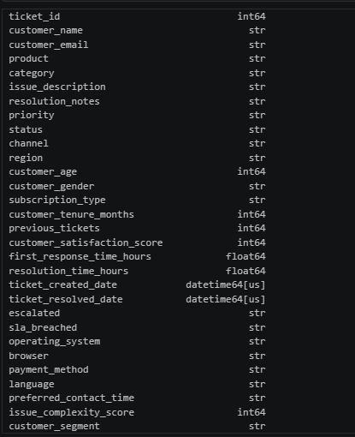
Data Types Changing
Code
df['ticket_created_date'] = pd.to_datetime(
df['ticket_created_date'])
df['ticket_resolved_date'] = pd.to_datetime(
df['ticket_resolved_date'])
df[['ticket_created_date',
'ticket_resolved_date']].dtypes

Slide 11
Data Types & Missing Values Handling
Code
df['ticket_created_date'] = pd.to_datetime(
df['ticket_created_date'])
df['ticket_resolved_date'] = pd.to_datetime(
df['ticket_resolved_date'])
df[['ticket_created_date',
'ticket_resolved_date']].dtypes
Code
df.drop(columns=['browser'], inplace=True)
print('browser' in df.columns)
print(df.shape)

Slide 12
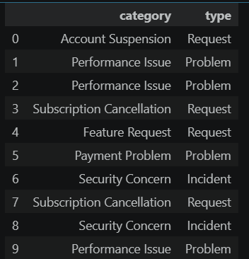
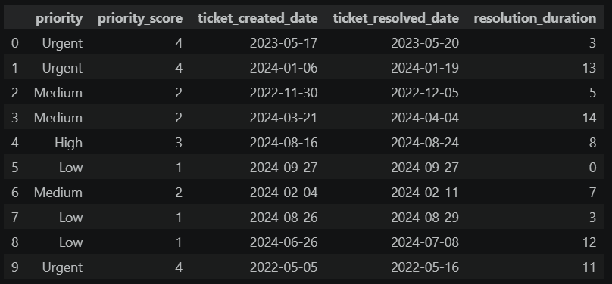
Creating New Features
Type
Resolution_Duration and Priority_Score

Slide 13
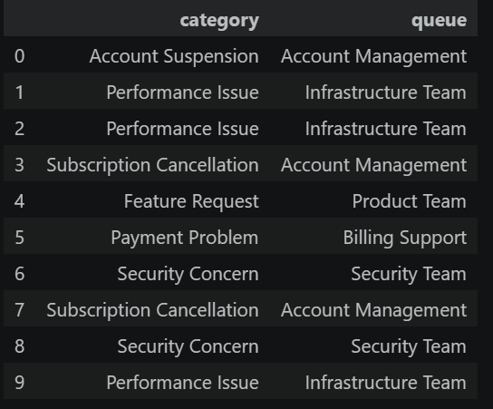
Creating New Features
Queue

Slide 14
MILESTONE 2
Exploratory Visualization & Similarity and Cluster Insights
Module 3: – Exploratory Visualization | Module 4:- Similarity and Cluster Insights

Slide 15
MODULE 3
Exploratory Visualization
Plot ticket type distribution
Identify top categories and clusters by frequency
Visualize tickets by priority and queue

Slide 16
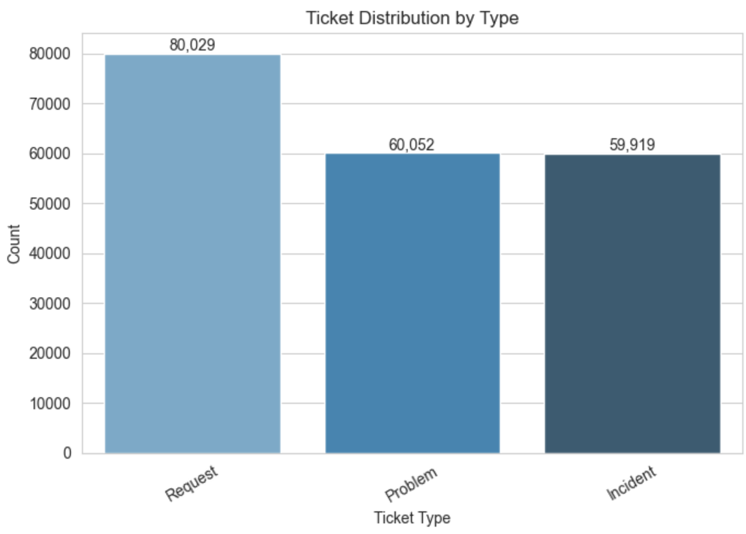
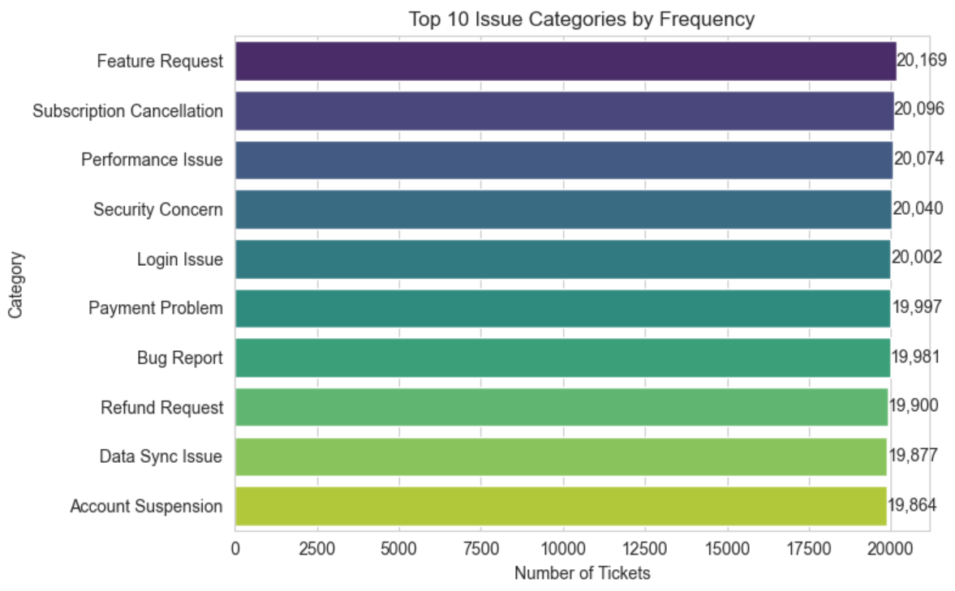
Exploratory Visualization
Ticket Count By Type
Top 10 Issue Categories
"Request" is the largest ticket type (~80K), while Problem and Incident are close to each other (~60K each).
Requests make up roughly 40% of all tickets, more than the other two types combined proportionally.
All 10 categories have nearly the same volume (~19,800–20,200 tickets each), with Feature Request slightly on top and Account Suspension slightly lowest.
No single issue category dominates — problems are spread almost evenly across all types.

Slide 17
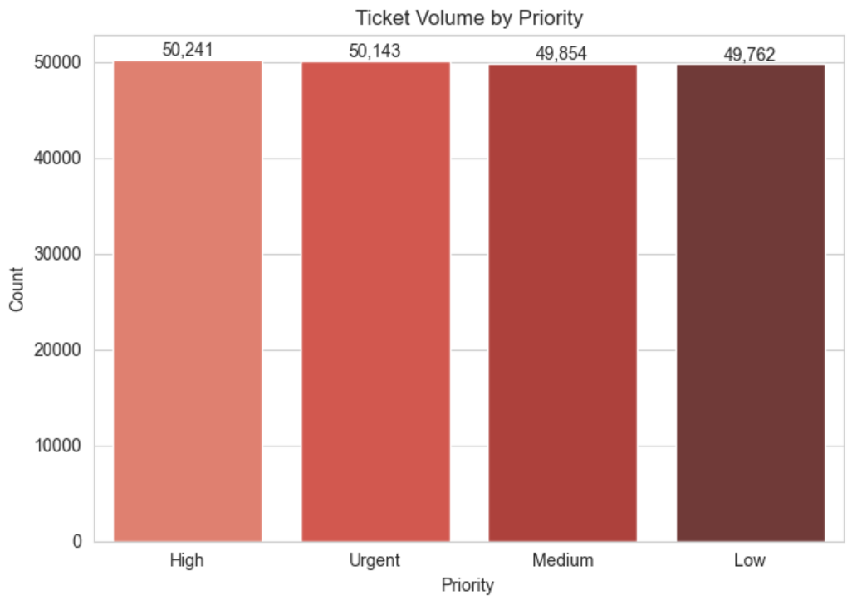
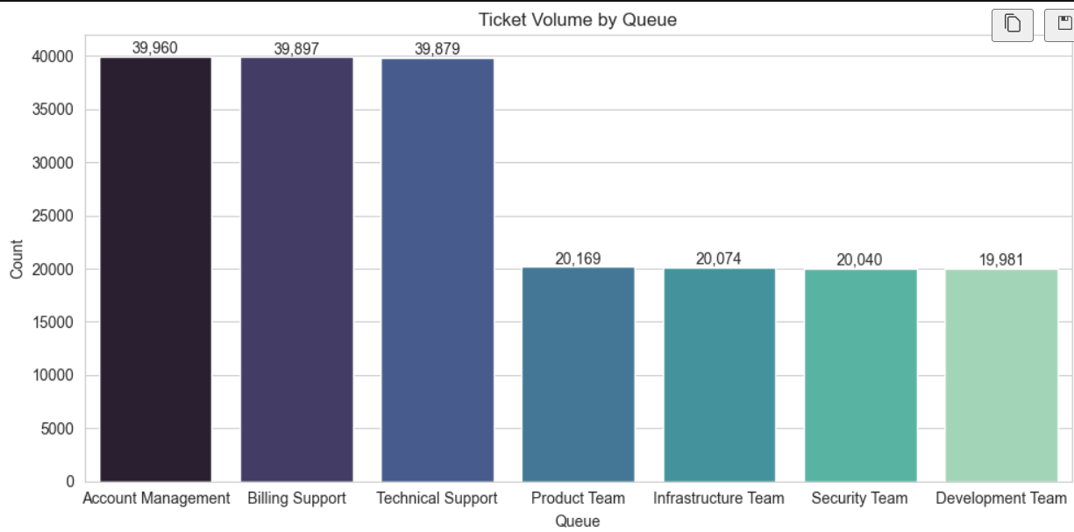
Exploratory Visualization
Ticket Count By Type
Top 10 Issue Categories
All priorities (High, Urgent, Medium, Low) have nearly equal volume (~50K each).
No priority level is over- or under-represented — tickets are evenly split by priority.
Account Management, Billing Support, and Technical Support each handle almost double (~40K each) the tickets of the other four teams (~20K each).
Support workload is concentrated in 3 queues, while Product, Infrastructure, Security, and Development teams share a smaller, evenly split load.

Slide 18
MODULE 4
Similarity and Cluster Insights
Analyze average similarity scores within clusters
Compare cluster size vs. issue type
Visualize performance gaps using boxplots and scatter plots
Deliverables: Minimum 8 visualizations, Summary of key patterns and problem clusters

Slide 19
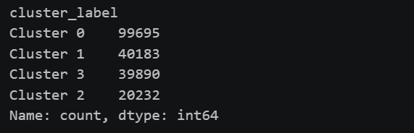
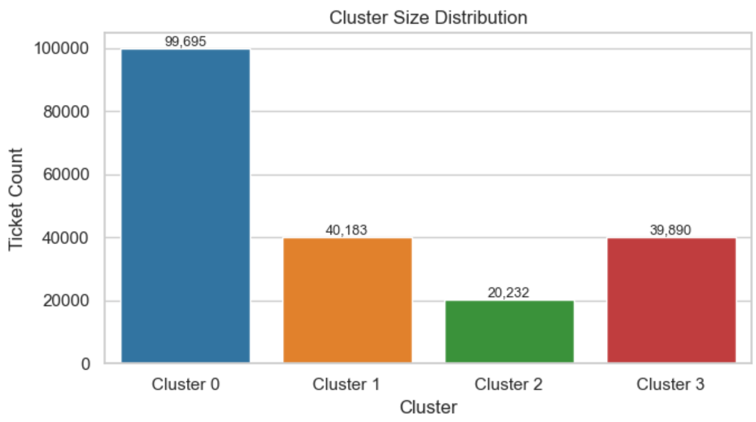
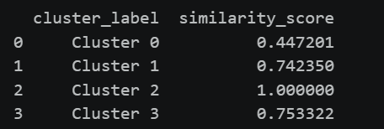
Clustering
Labeling The Cluster
Cluster Size Distribution
Compute Cosine Similarity Scores
Cluster 0 is by far the largest, with ~99,695 tickets — almost half of all tickets.
Clusters 1 and 3 are similar in size (~40K each), while Cluster 2 is the smallest (~20K) — so ticket clusters are unevenly distributed, unlike most other metrics in this data.

Slide 20
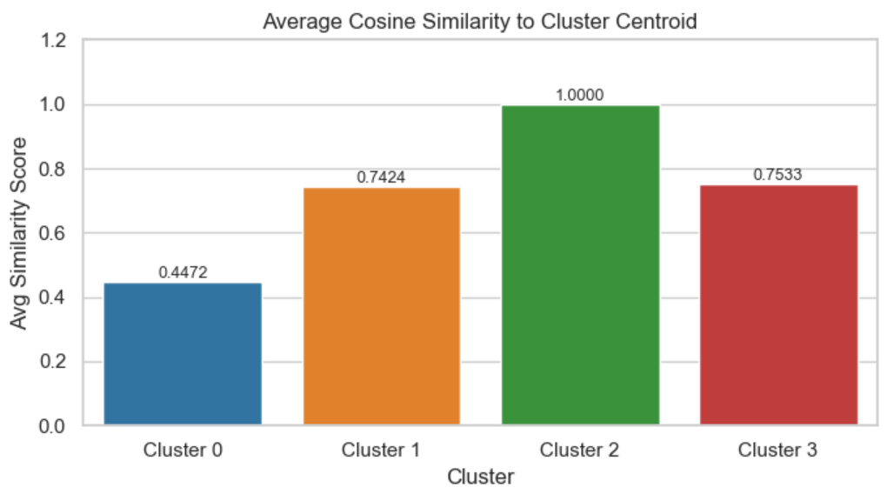
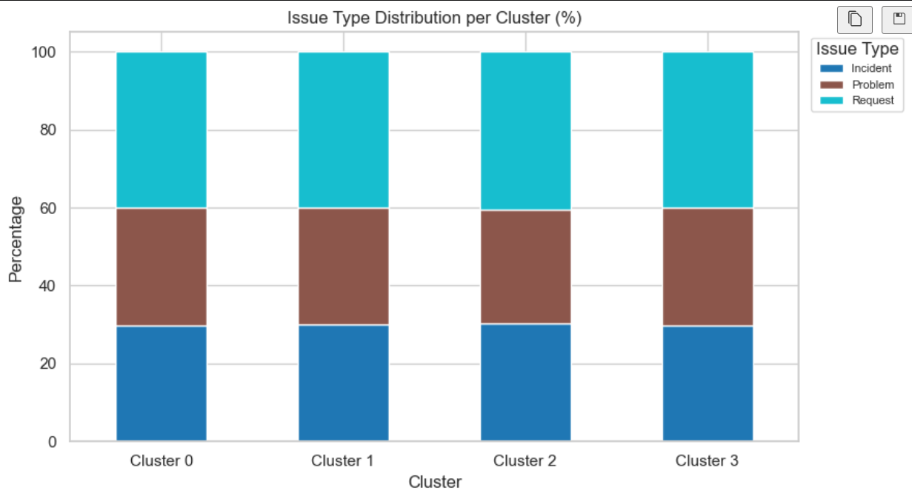
Clustering
Cluster Size Distribution
Cluster vs Issue Type (Stacked Bar)
Cluster 2 has a perfect similarity score (1.0), meaning all its tickets are almost identical to each other.
Cluster 0 has the lowest score (0.45), meaning it's the most diverse/mixed group of tickets.
All 4 clusters have nearly the same mix of issue types — around 30% Incident, 30% Problem, 40% Request.
Issue type distribution doesn't change much across clusters, so what makes clusters different isn't the type of issue, but likely something else (like similarity/content, as seen in the other chart).

Slide 21
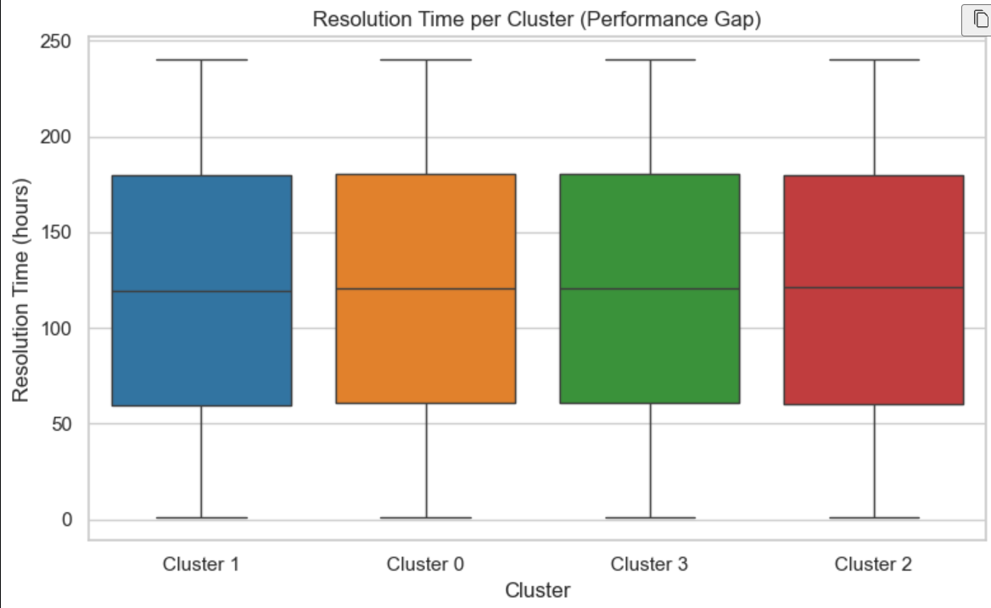
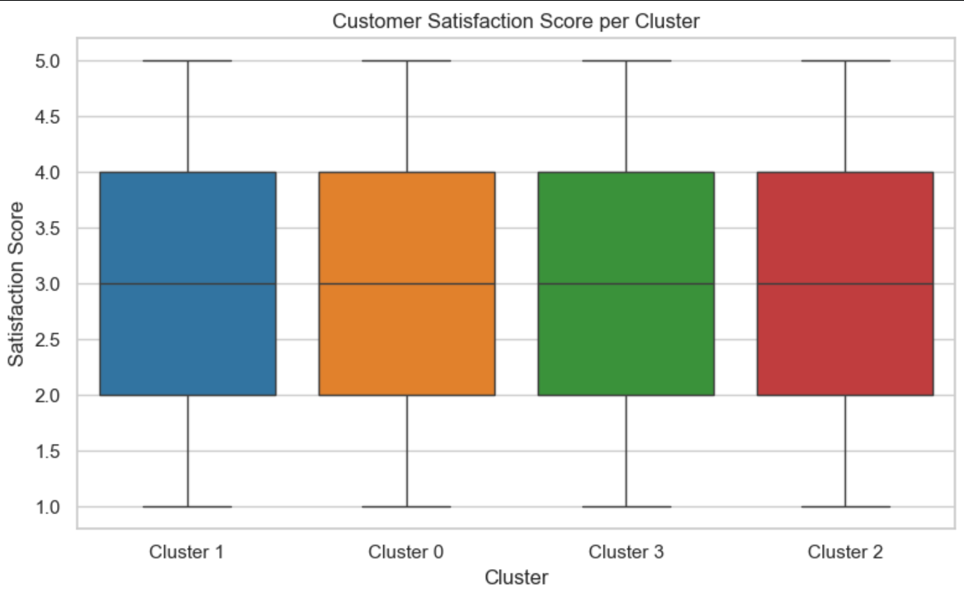
Clustering
Resolution Time Boxplot per Cluster (Performance Gap)
Customer Satisfaction Score Boxplot per Cluster
All 4 clusters have a very similar spread of resolution times (median ~120 hours, range roughly 0–240 hours).
No cluster resolves tickets noticeably faster or slower — resolution time patterns look basically the same everywhere.
All clusters have the same median satisfaction score (~3.0) and similar spread (1 to 5).
Satisfaction doesn't differ meaningfully by cluster — every cluster has the same range of happy and unhappy customers.

Slide 22
MILESTONE 3
Performance Trend Analysis & Geographic and Category-Level Insights
Module 5:- Performance Trend Analysis | Module 6:- Geographic and Category-Level Insights

Slide 23
MODULE 5
Performance Trend Analysis
Analyze average resolution times by priority and type
Determine which countries or teams handle tickets fastest
Identify high-priority unresolved issues

Slide 24
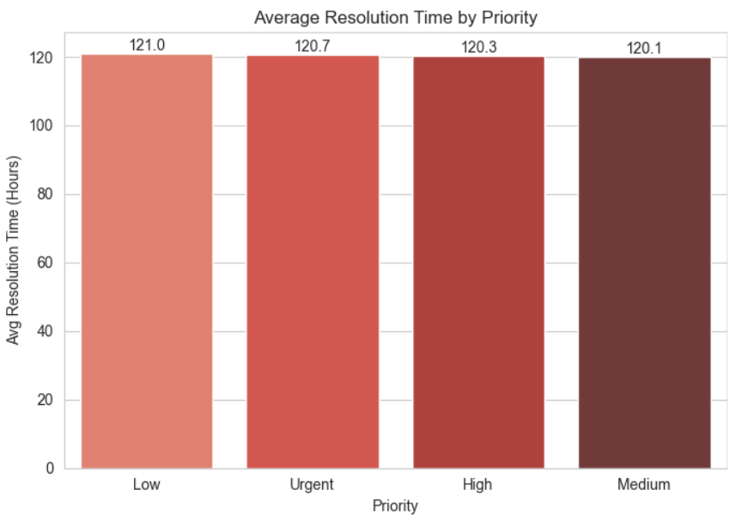
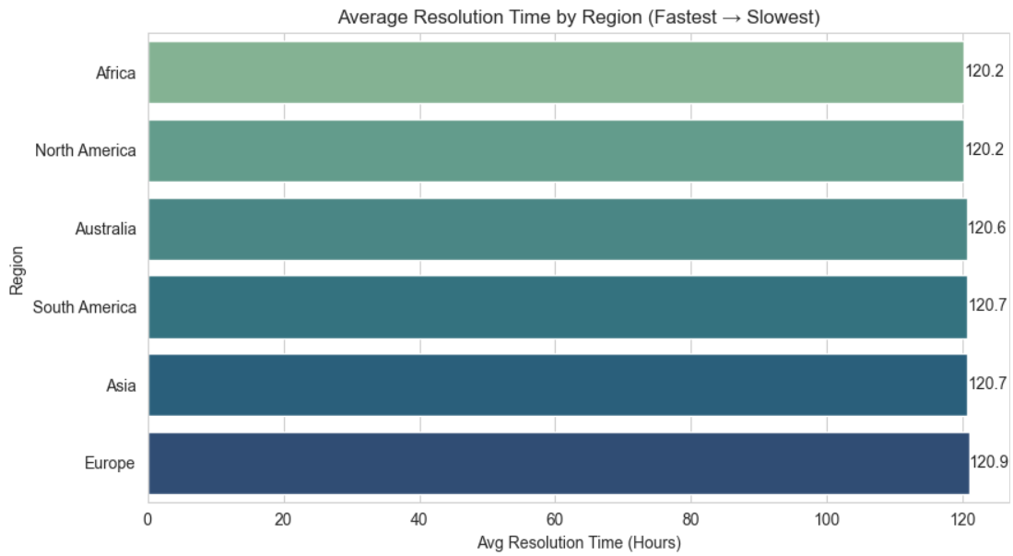
Performance Trend Analysis
Average Resolution Time by Priority
Average Resolution Time by Region
Low, Urgent, High, and Medium tickets all take about the same time (~120 hours) to resolve.
Priority doesn't really speed things up - even "Urgent" isn't much faster than "Low."
Every region takes roughly the same time too (~120 hours).
Europe is a touch slower, Africa/North America a touch faster, but the difference is tiny.

Slide 25
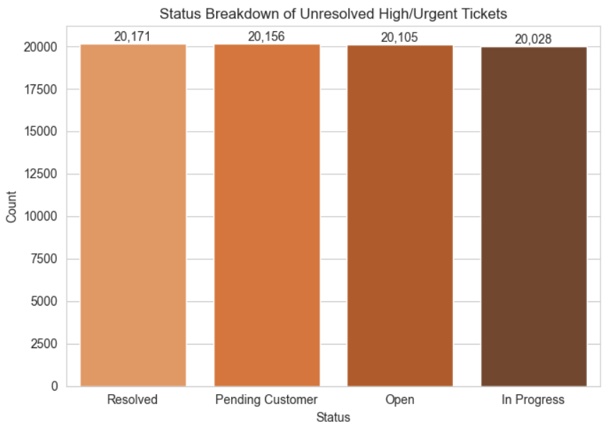
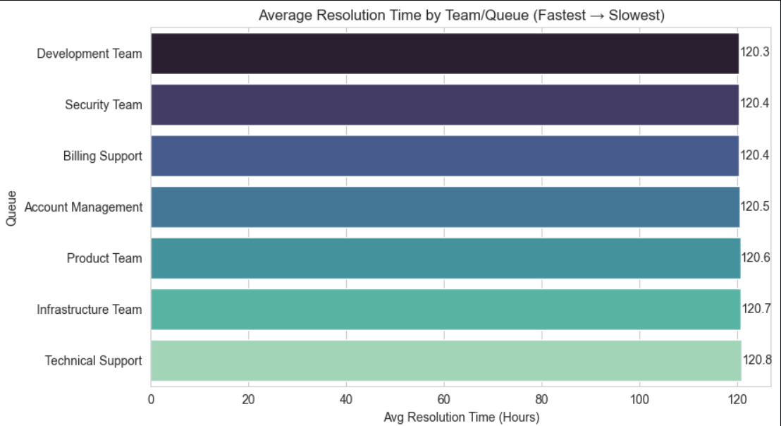
Performance Trend Analysis
Average Resolution Time by Queue
Status Breakdown of Unresolved High/Urgent Tickets
All teams take about the same time (~120 hours), from Development Team (fastest) to Technical Support (slowest).
No team is significantly faster or slower — the gap between best and worst is barely half an hour.
Tickets are almost evenly split across Resolved, Pending Customer, Open, and In Progress — all around 20,000 each.
A huge number of High/Urgent tickets (~20,000 each stage) are still stuck unresolved, showing a major backlog regardless of status.

Slide 26
MODULE 6
Geographic and Category-Level Insights
Create heatmaps of ticket concentration by region
Map issue categories geographically using latitude/longitude
Evaluate the relationship between cluster size and performance score
Deliverables: Performance metrics summary, Geo-visualizations and comparative charts

Slide 27
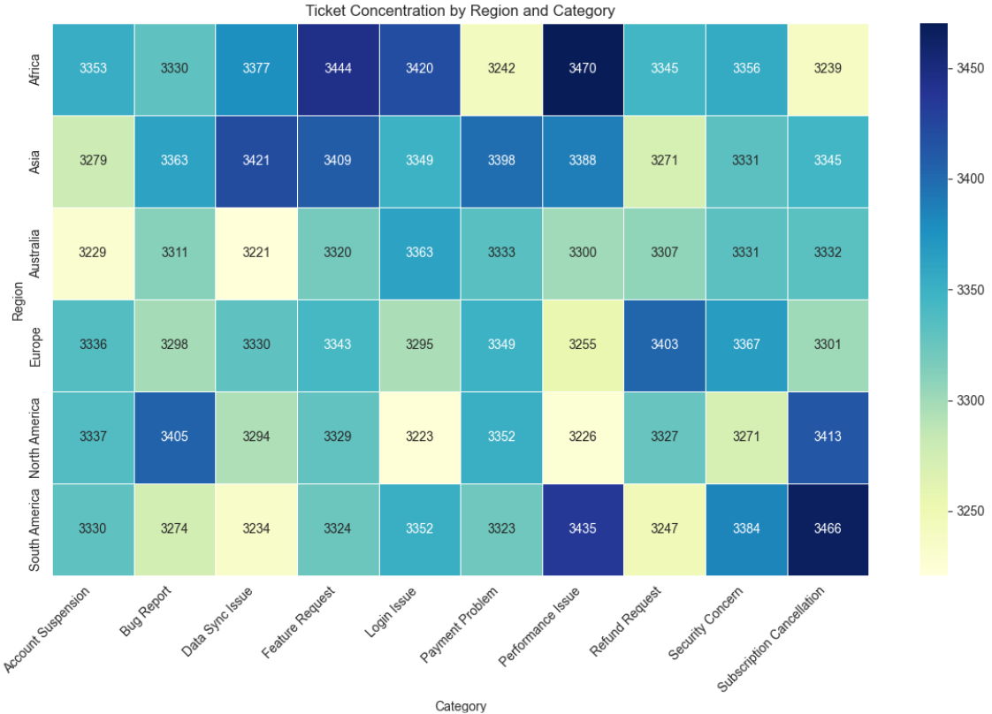
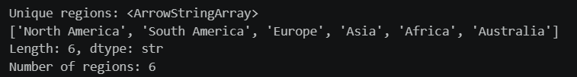
Geographic and Category-Level Insights
Confirm what 'region' actually contains
Heatmap: Ticket Concentration by Region x Category
There are exactly 6 unique regions in the data — North America, South America, Europe, Asia, Africa, and Australia.
This confirms the "region" field is clean, with no duplicates or unexpected values.
Ticket counts are fairly evenly spread (~3,200–3,470 per cell), no single region or category dominates overall.
Some hotspots stand out — like Africa's "Performance Issue" and North America's "Bug Report" — showing slightly higher concentrations of specific problems in specific regions.

Slide 28
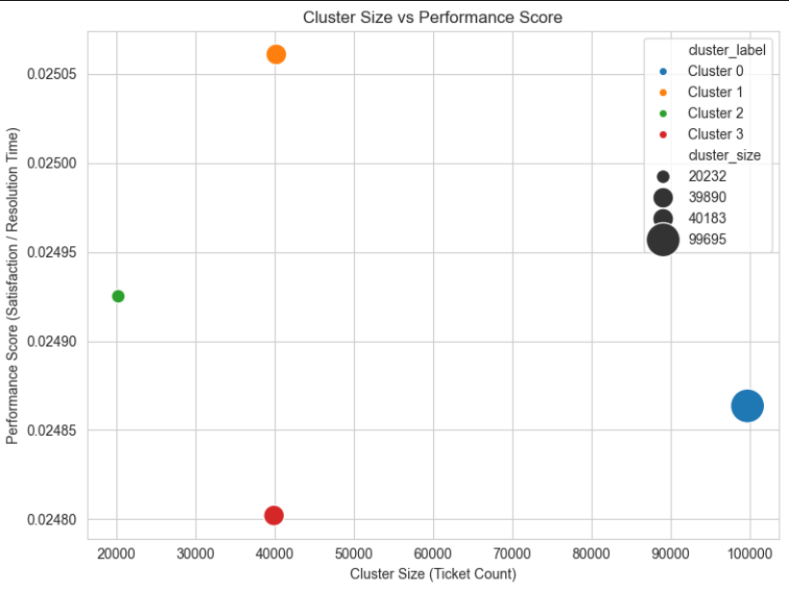
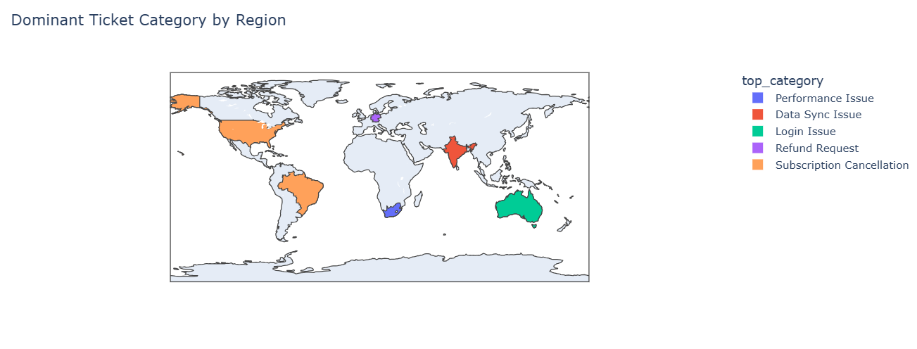
Geographic and Category-Level Insights
Geographic Mapping — region -> country centroid lookup
Cluster Size vs Performance Score
Most regions (North America, South America, Africa, Australia) are dominated by "Subscription Cancellation" tickets.
Asia stands out differently — dominated by "Data Sync Issue".
There are 4 ticket clusters of very different sizes — the biggest (Cluster 0, ~99,695 tickets) has the lowest performance score, while the smallest clusters have higher scores.
Bigger clusters tend to have slightly worse performance scores, suggesting that as ticket volume grows in a cluster, satisfaction/resolution efficiency dips a bit.

Slide 29
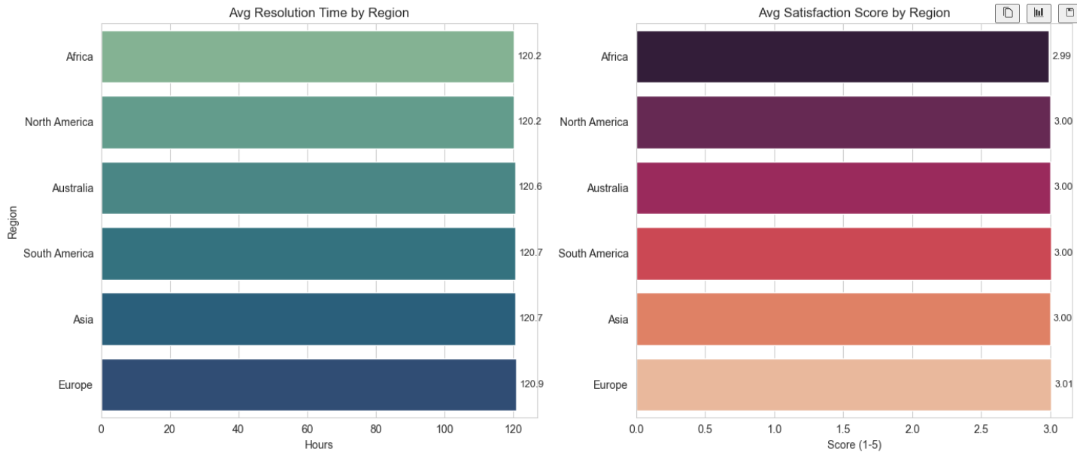
Geographic and Category-Level Insights
Average Satisfaction score by Region
Satisfaction scores are also nearly identical across regions, all sitting around 3.0 (out of 5).
No region stands out as clearly happier or unhappier — satisfaction looks flat everywhere.

Slide 30
MILESTONE 4
Dashboard/Report Preparation & Documentation and Presentation
Module 7:- Dashboard/Report Preparation | Module 8 :- Documentation and Presentation

Slide 31
MODULE 7
Dashboard/Report Preparation
Combine visual insights into an interactive Power BI or Streamlit dashboard
Organize visualizations into performance KPIs: Average Resolution Time, Most Frequent Categories, Cluster Similarity Index, Top Performing Regions

Slide 32
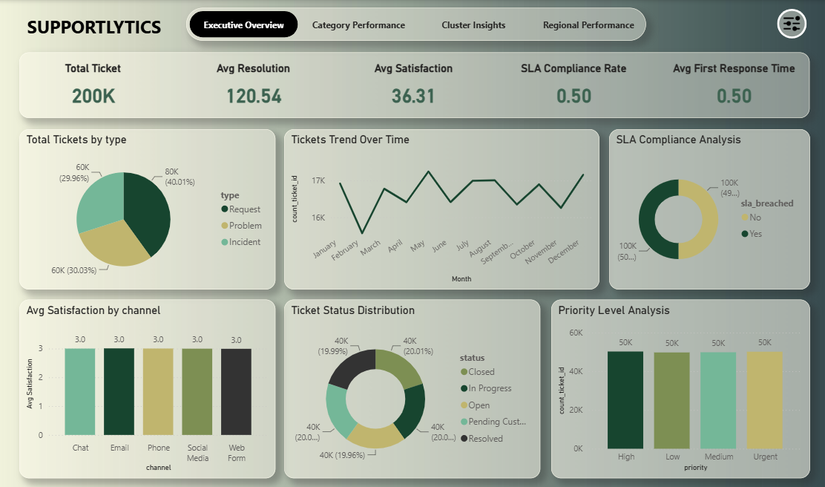
Dashboard/Report Preparation
Page 1: Executive Overview
Top numbers: 200K tickets total, ~120 hrs to resolve, satisfaction and SLA numbers look off/need checking.
Ticket Type: Requests are the biggest chunk (40%), Incidents and Problems split the rest evenly.
Trend Over Time: Ticket volume goes up and down each month, no clear pattern.
SLA Compliance: Exactly half of tickets breached SLA, half didn't.
Satisfaction by Channel: Every channel (chat, email, phone, etc.) scores the same — 3.0. No difference between them.
Ticket Status: Tickets are spread evenly across all statuses (Open, Closed, In Progress, etc.) — about 20% each.
Priority Level: High, Low, Medium, Urgent all have the exact same number of tickets (50K each).

Slide 33
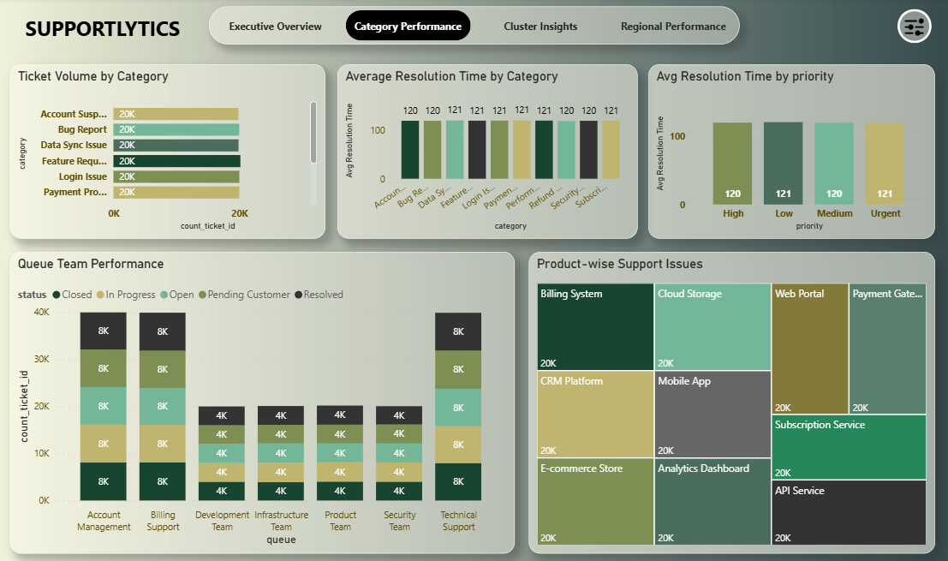
Dashboard/Report Preparation
Page 2: Category Performance
Ticket Volume by Category: All categories (Account Suspension, Bug Report, Data Sync, etc.) have exactly 20K tickets each — perfectly even.
Avg Resolution Time by Category: Every category takes about the same time, ~120–121 hours, no real difference between them.
Avg Resolution Time by Priority: High, Low, Medium, Urgent all take ~120–121 hours too — priority doesn't speed things up.
Queue Team Performance: Account Management, Billing Support, and Technical Support handle more tickets (~40K each) than the other four teams (~20K each), but status mix (Open, Closed, etc.) is evenly split within each.
Product-wise Support Issues: Every product (Billing System, Cloud Storage, CRM, etc.) has the same 20K tickets — no product stands out as more problematic.

Slide 34
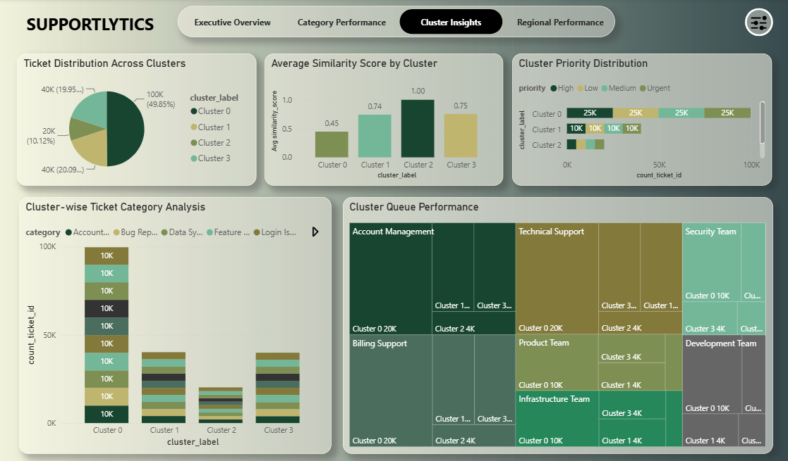
Dashboard/Report Preparation
Page 3: Cluster Insights
Ticket Distribution Across Clusters: Cluster 0 is the biggest (~50% of all tickets), followed by Cluster 3 (20%), Cluster 2 (20%), and Cluster 1 (10%) — clusters are unevenly sized.
Avg Similarity Score by Cluster: Cluster 2 has the highest similarity (1.00, meaning tickets inside it are very alike), while Cluster 0 has the lowest (0.45, meaning it's the most mixed/diverse group.
Cluster Priority Distribution: Cluster 0 has the most tickets split evenly across all 4 priorities (25K each); Cluster 1 is smaller but still evenly split (10K each).
Cluster-wise Ticket Category Analysis: Cluster 0 has way more tickets across every category (~10K each) compared to Clusters 1, 2, and 3, which are much smaller.
Cluster Queue Performance: Cluster 0 dominates every team's workload (Account Management, Technical Support, Billing Support, etc.), while Clusters 1–3 contribute smaller, similar-sized shares.

Slide 35
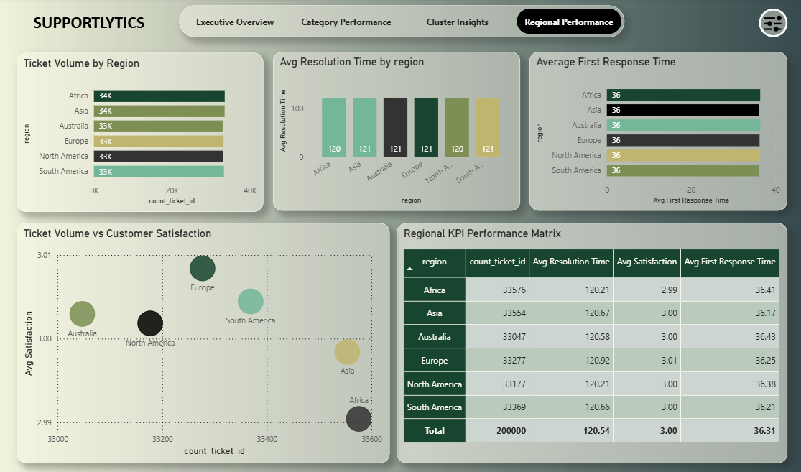
Dashboard/Report Preparation
Page 4: Regional Performance
Avg Resolution Time by Region: Resolution time is nearly identical everywhere (~120–121 hours), regardless of region.
Average First Response Time: All regions respond in about the same time too (~36 hours) — flat across the board.
Ticket Volume vs Customer Satisfaction: Satisfaction scores barely vary (2.99–3.01) across regions, and there's no real link between ticket volume and satisfaction — it's basically random scatter.
Regional KPI Matrix: Confirms everything above in one table — every region is nearly identical on volume, resolution time, satisfaction, and response time, with only tiny decimal-level differences.

